Slide 1
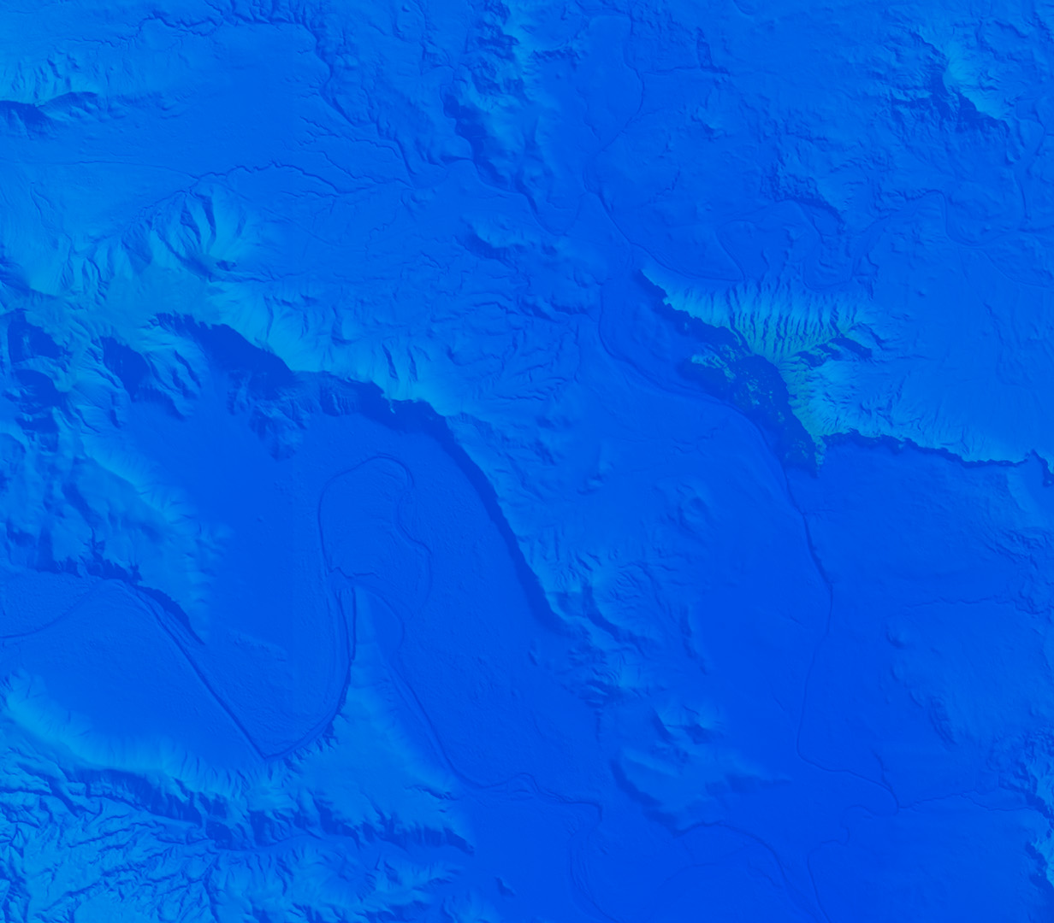

Developer Summit Synopsis Mark Grinberg 3/21/25

Slide 2

Agenda
General Overview
What is ESRI
Software Models / Apps
APIs / SDKs Documentation
Demo
No Components vs. Components
Calcite
Accessibility
Feature Service & Auth
3D Boston
Conclusions / Resources / Questions

Slide 3

What is ESRI?
I promise, I’m not a fanboy but…
Founded in 1969 by Jack Dangermond
“Environmental Systems Research Institute”
As of 2011, ESRI has 40% of GIS marketshare
~30% of revenue goes towards R&D annually
Arc/Info -> ArcMap -> ArcPro

Slide 4
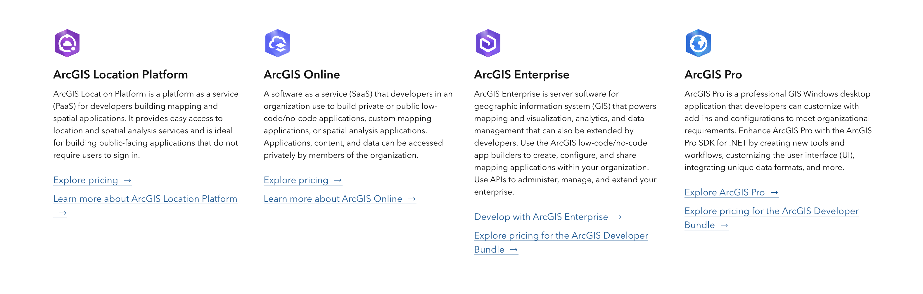
What is ESRI: Software Models

Slide 5
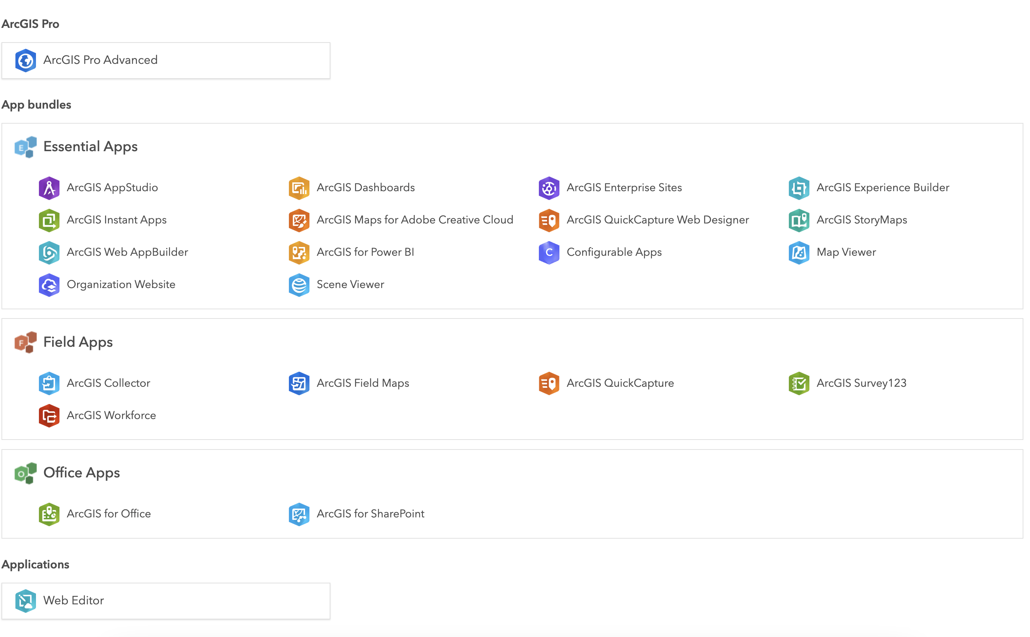
What is ESRI: “Apps”
https://www.esri.com/en-us/arcgis/products/index

Slide 6
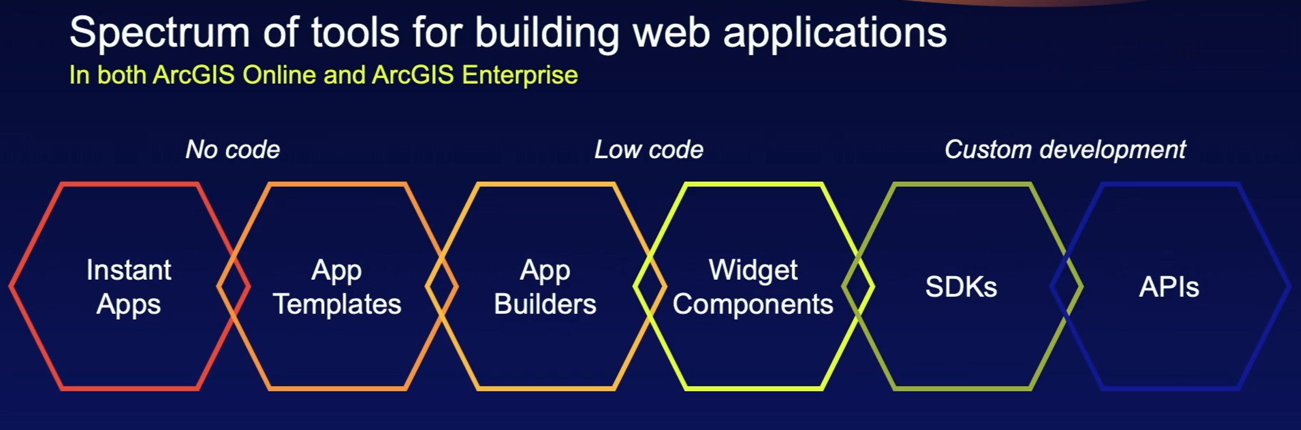
What is ESRI: “Apps”

Slide 7
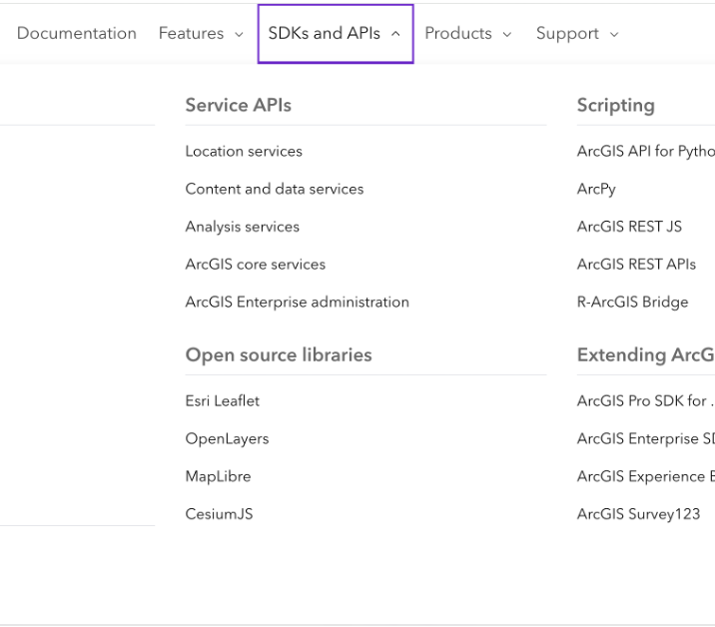
SDKs, APIs, Documentation
https://developers.arcgis.com/documentation/
Notes:
Actually walk through documentation

Slide 8
ESRI Dev Summit
Best Sessions:
Accessibility for Web Maps
Web Editing
3D Mapping
Speedgeeking
Geometric Operators
ArcGIS Routing Services w/ OpenLayers
Time Data w/ the JavaScript API
Working with Imagery using the JavaScript SDK
Notes:
Accessibility:
WCAG 2.1, currently 2.2, goes into A, AA, AAA
We use Aria = Accessible Rich Internet Applications
…could be a whole nother dev lunch using Aria-live, aria-describedby, aria-label. No aria is better than bad aria though!
Focus trapping, animations, etc.
Web Editing:
Editing a feature service, very cool, easy to apply edits and store your data in this way with many built in components for doing so.
3d Mapping:
ESRI’s 3D capabilities are quite good – because the data and 3d meshes exist close to where you are doing the data. More on this later.
SpeedGeeking
Geometric Operators in ESRI
How to do things like buffers, measurements, projections, contains/crosses/etc. client-side
Routing Services with OpenLayers:
Using Location Platform Services to do routing in OpenLayers
Time Data w/ ESRI Javascript API:
Updating with pushes and pulls (streamLayers, can connect to a stream service or a custom websocket service)
Imagery:
Different types of imagery in ESRI, how it is handled, how to query, etc.

Slide 9


Slide 10
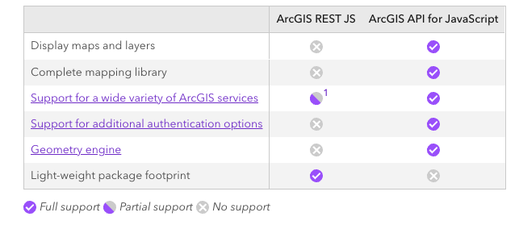
Demo
https://developers.arcgis.com/arcgis-rest-js/faq/#fn:support-table-1:0

Slide 11
Conclusions
“It is tempting, if the only tool you have is a hammer, to treat everything as if it were a nail.”
Advantages of using ESRI “stack”:
Existing Infrastructure / Data
Infrastructure and Data live together
Calcite?
Disadvantages
Documentation can often be lacking
Costly, even with location platform services
Can mix and match technologies (feature services in OpenLayers / Leaflet)
Opportunities to use ESRI Javascript API to make our lives a little easier…maybe?
Ultimately, having skills across various technologies allows us to advise clients/PMs with the best possible options and their pros/cons.

Slide 12
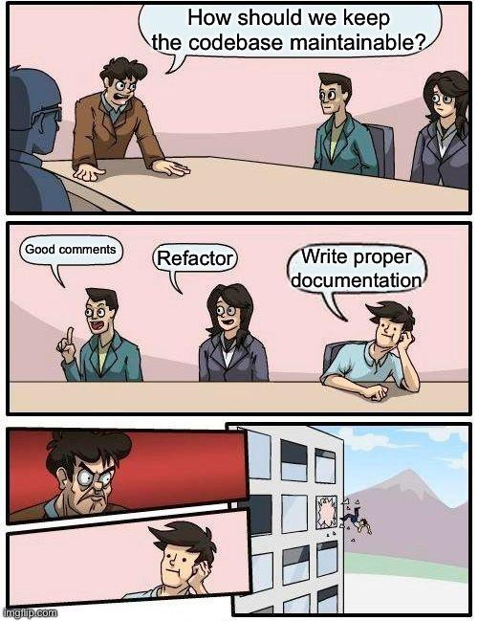
Documentation & Resources
Github Repo containing demo code & notes:
https://github.com/sanborn/esri_devsummit_2025
Documentation and Samples:
https://developers.arcgis.com/javascript/latest/
https://developers.arcgis.com/javascript/latest/sample-code/
https://github.com/Esri/jsapi-resources
https://github.com/EsriDevEvents
VSCode Snippets:
https://marketplace.visualstudio.com/items?itemName=Esri.arcgis-maps-sdk-js-snippets
ESRI Javascript API Product Blog:
https://www.esri.com/arcgis-blog/products/js-api-arcgis/

Slide 13

Questions?

Slide 14

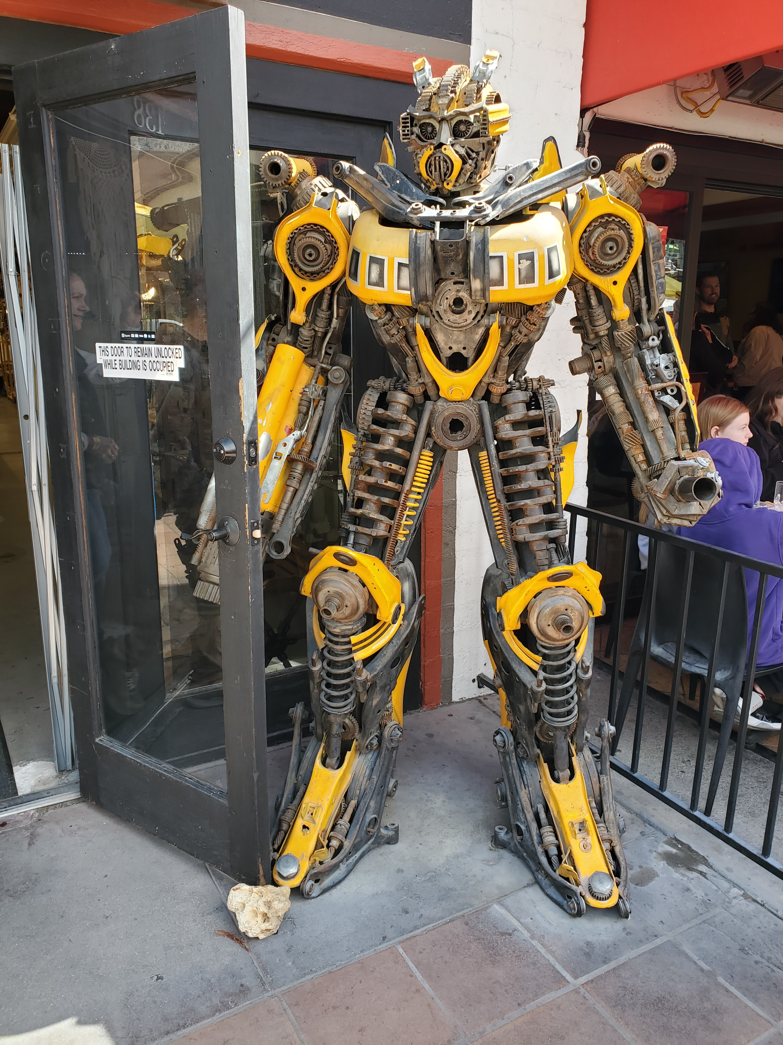


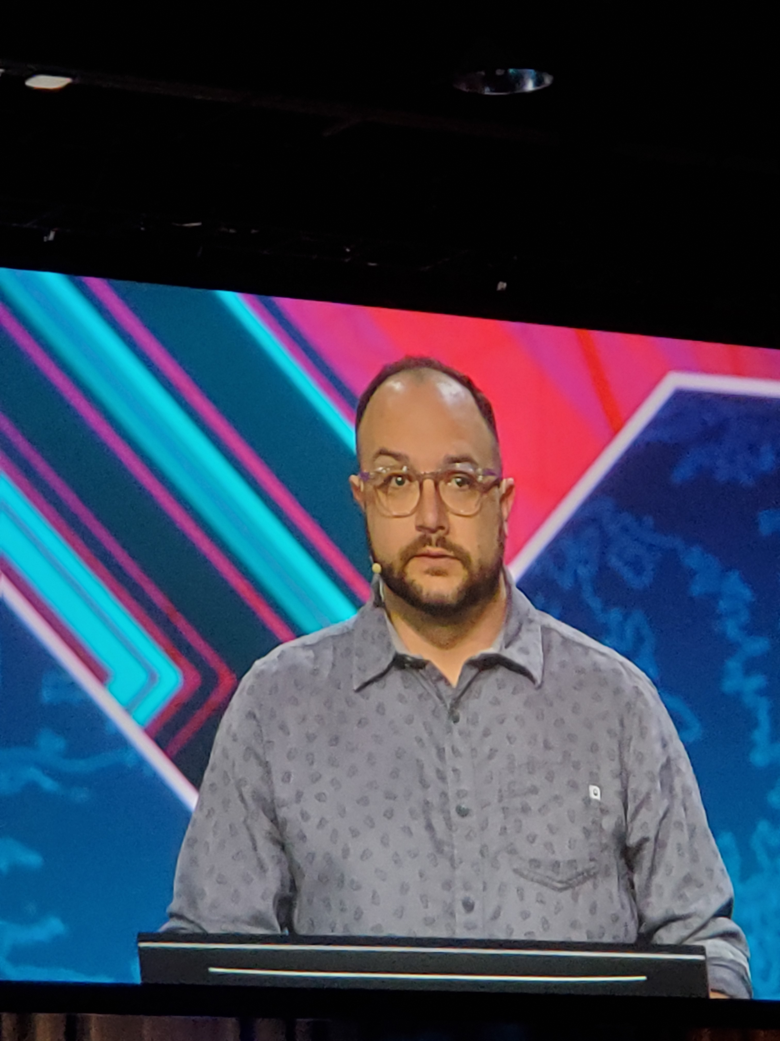
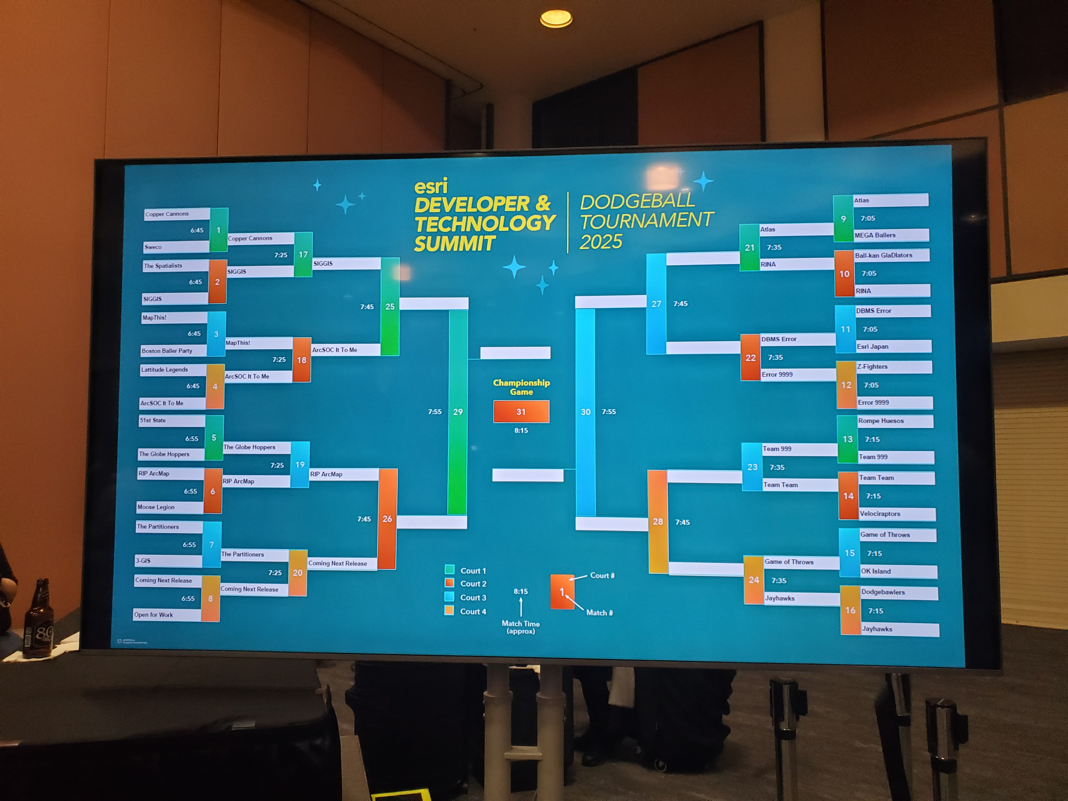
Fun & Miscellany

